Slide 1
Chapter 13
Concurrency

Slide 2
Key Concepts *
High-level statement concurrency
Subprogram-level concurrency
Synchronization
  Semaphores
  Monitors
  Message Passing
Copyright © 2015 Pearson. All rights reserved.
1-<number>

Slide 3
Chapter 13 Topics
Introduction
Introduction to Subprogram-Level Concurrency
Semaphores
Monitors
Message Passing
Ada support for Concurrency
Concurrency in Functional Languages
Statement-Level Concurrency
Copyright © 2015 Pearson. All rights reserved.
1-<number>

Slide 4
Introduction
Concurrency can occur at four levels:
  Machine instruction level
  High-level language statement level *
  Unit level *
  Program level
Because there are no language issues in instruction- and program-level concurrency, they are not addressed here
Copyright © 2015 Pearson. All rights reserved.
1-<number>

Slide 5
Multiprocessor Architectures *
Single-Instruction Multiple-Data (SIMD) machines
Multiple-Instruction Multiple-Data (MIMD) machines
A primary focus of this chapter is shared memory MIMD machines (multiprocessors)
Copyright © 2015 Pearson. All rights reserved.
1-<number>

Slide 6
SIMD Example 1
Group Demo!
Copyright © 2015 Pearson. All rights reserved.
1-<number>

Slide 7
SIMD Example
array (1…12)
for i from 1 to 12
array (i) *= 2
“Unroll” loop
Each processor simultaneously processes a different piece of it.
array(1)
array(2)
array(3)
…
Processor 1
Processor 2
Processor 3
…
Copyright © 2015 Pearson. All rights reserved.
1-<number>

Slide 8
MIMD Example 1
Group Demo!
Copyright © 2015 Pearson. All rights reserved.
1-<number>

Slide 9
MIMD Example
thread t1 {
thread definition }
thread t2 {
thread definition }
P1 executes t1
P2 executes t2
Both happen simultaneously
Copyright © 2015 Pearson. All rights reserved.
1-<number>

Slide 10
Categories of Concurrency
Categories of Concurrency:
  Physical concurrency - Multiple independent processors ( multiple threads of control)
  Logical concurrency - The appearance of physical concurrency is presented by time-sharing one processor (software can be designed as if there were multiple threads of control)
Coroutines (quasi-concurrency) have a single thread of control
A thread of control in a program is the sequence of program points reached as control flows through the program
Copyright © 2015 Pearson. All rights reserved.
1-<number>

Slide 11
Motivations for the Use of Concurrency
Multiprocessor computers capable of physical concurrency are now widely used
Even if a machine has just one processor, a program written to use concurrent execution can be faster than the same program written for nonconcurrent execution (I/O)
Involves a different way of designing software that can be very useful—many real-world situations involve concurrency
Many program applications are now spread over multiple machines, either locally or over a network
Copyright © 2015 Pearson. All rights reserved.
1-<number>

Slide 12
Introduction to Subprogram-Level Concurrency
A task or process or thread is a program unit that can be in concurrent execution with other program units
Tasks differ from ordinary subprograms in that:
  A task may be implicitly started
  When a program unit starts the execution of a task, it is not necessarily suspended
  When a task’s execution is completed, control may not return to the caller
Tasks usually work together
Copyright © 2015 Pearson. All rights reserved.
1-<number>

Slide 13
Task Synchronization *
A mechanism that controls the order in which tasks execute
Two kinds of synchronization
  Cooperation synchronization *
  Competition synchronization *
Task communication is necessary for synchronization, provided by: *
- Shared nonlocal variables
- Parameters
- Message passing
Copyright © 2015 Pearson. All rights reserved.
1-<number>

Slide 14
Kinds of synchronization *
Cooperation: Task A must wait for task B to complete some specific activity before task A can continue its execution, e.g., the producer-consumer problem
Competition: Two or more tasks must use some resource that cannot be simultaneously used, e.g., a shared counter
  Competition is usually provided by mutually exclusive access (approaches are discussed later)
Copyright © 2015 Pearson. All rights reserved.
1-<number>

Slide 15
Synchronization Problem
Instruction: Shared_Sum = Px_My_Sum + Sum_Actual
1
2
3
4
5
6
P1_My_Sum = 6
Sum_Actual;
P2_My_Sum = 15
Sum_Actual;
Concurrent Execution: Shared_Sum = 0
Copyright © 2015 Pearson. All rights reserved.
1-<number>

Slide 16
Synchronization Problem
Instruction: Shared_Sum = Px_My_Sum + Sum_Actual
1
2
3
4
5
6
P1_My_Sum = 6
Sum_Actual = 0 + 6
P2_My_Sum = 15
Sum_Actual = 0 + 15
Access Simultaneously: Shared_Sum = 0
Copyright © 2015 Pearson. All rights reserved.
1-<number>

Slide 17
Synchronization Problem
Instruction: Shared_Sum = Px_My_Sum + Sum_Actual
1
2
3
4
5
6
P1_My_Sum = 6
Sum_Actual = 0 + 6
P2_My_Sum = 15
Sum_Actual = 0 + 15
Final Value?: Shared_Sum = 6, 15, 21
Copyright © 2015 Pearson. All rights reserved.
1-<number>

Slide 18
Scheduler
Providing synchronization requires a mechanism for delaying task execution
Task execution control is maintained by a program called the scheduler, which maps task execution onto available processors
Copyright © 2015 Pearson. All rights reserved.
1-<number>

Slide 19
Design Issues for Concurrency
Competition and cooperation synchronization*
Controlling task scheduling
How can an application influence task scheduling
How and when tasks start and end execution
How and when are tasks created
* The most important issue
Copyright © 2015 Pearson. All rights reserved.
1-<number>

Slide 20
Methods of Providing Synchronization *
Semaphores
Monitors
Message Passing
Copyright © 2015 Pearson. All rights reserved.
1-<number>

Slide 21
Semaphores *
Dijkstra - 1965
A semaphore is a data structure consisting of a counter and a queue for storing task descriptors
  A task descriptor is a data structure that stores all of the relevant information about the execution state of the task
Semaphores can be used to implement guards on the code that accesses shared data structures
Semaphores have only two operations, wait and release (originally called P and V by Dijkstra)
Semaphores can be used to provide both competition and cooperation synchronization
Copyright © 2015 Pearson. All rights reserved.
1-<number>

Slide 22
Competitive Synchronization Solution Using Semaphores as Guards
Group Demo!
Copyright © 2015 Pearson. All rights reserved.
1-<number>

Slide 23
Semaphor – Guard Example
P1: my_sum
sum_actual
P2: my_sum
sum_actual
Semaphore:
counter
queue
Shared_Sum = 0
1
2
3
4
1-<number>

Slide 24
Semaphor – Guard Example
P1: my_sum = 3
sum_actual;
P2: my_sum = 7
sum_actual;
Semaphore:
counter = 1
queue = empty
Shared_Sum = 0
1
2
3
4
1-<number>

Slide 25
Semaphor – Guard Example
P1: my_sum = 3
sum_actual;
P2: my_sum = 7
sum_actual = 0 + 7;
Semaphore:
counter = 0
queue = empty
Shared_Sum = 0
1
2
3
4
P2 accessed first.
1-<number>

Slide 26
Semaphor – Guard Example
P1: my_sum = 3
sum_actual;
P2: my_sum = 7
sum_actual = 0 + 7;
Semaphore:
counter = 0
queue = P1
Shared_Sum = 0
1
2
3
4
P1 attempts access.
1-<number>

Slide 27
Semaphor – Guard Example
P1: my_sum = 3
sum_actual;
P2: my_sum = 7
sum_actual = 0 + 7;
Semaphore:
counter = 0
queue = P1
Shared_Sum = 7
1
2
3
4
P2 updates Shared_sum.
1-<number>

Slide 28
Semaphor – Guard Example
P1: my_sum = 3
sum_actual;
P2: my_sum = 7
sum_actual = 0 + 7;
Semaphore:
counter = 1
queue = P1
Shared_Sum = 7
1
2
3
4
P2 “releases” semaphore.
1-<number>

Slide 29
Semaphor – Guard Example
P1: my_sum = 3
sum_actual = 7 + 3;
P2: my_sum = 7
sum_actual = 0 + 7;
Semaphore:
counter = 0
queue = empty
Shared_Sum = 7
1
2
3
4
P1 done “waiting”.
1-<number>

Slide 30
Semaphor – Guard Example
P1: my_sum = 3
sum_actual = 7 + 3;
P2: my_sum = 7
sum_actual = 0 + 7;
Semaphore:
counter = 1
queue = empty
Shared_Sum = 10
1
2
3
4
P1 updates Shared_sum and “releases” semaphore.
1-<number>

Slide 31
In-Class Exercise Cooperation Synchronization
Use semaphores to solve the cooperation synchronization problem for a producer-consumer example with a shared buffer.
Show what a producer task would do (algorithmically)
Show what a consumer task would do (algorithmically)
How many semaphores do we need?
  Is 1 enough?
  What starting state would your semaphore(s) have?
Copyright © 2015 Pearson. All rights reserved.
1-<number>

Slide 32
In-Class Exercise Cooperation Synchronization
Need 2 semaphores.
Semaphores don’t have an “upper limit”. (Some language implementation actually do allow you to specify an upper limit).
Spots_Full:
Counter = 0
queue empty
Spots_Empty:
Counter = 10
queue empty
1-<number>

Slide 33
In-Class Exercise Cooperation Synchronization
Producer Task(s)
sem_wait(Spots_Empty)
//decrements counter for Spots_Empty Semaphore
write_one_to_buffer
sem_release(Spots_Full)
//increments counter for Spots_Full Semaphore
If Spots_Empty’s counter is 0, then this task is added to Spots_Empty’s queue
1-<number>

Slide 34
In-Class Exercise Cooperation Synchronization
Consumer Task(s)
sem_wait(Spots_Full)
//decrements counter for Spots_Full Semaphore
write_one_to_buffer
sem_release(Spots_Empty)
//increments counter for Spots_Empty Semaphore
If Spots_Full’s counter is 0, then this task is added to Spots_Full’s queue
1-<number>

Slide 35
Cooperation Synchronization with Semaphores
Example: A shared buffer
The buffer is implemented as an ADT with the operations DEPOSIT and FETCH as the only ways to access the buffer
Use two semaphores for cooperation: emptyspots and fullspots
The semaphore counters are used to store the numbers of empty spots and full spots in the buffer
Copyright © 2015 Pearson. All rights reserved.
1-<number>

Slide 36
Cooperation Synchronization with Semaphores (continued)
DEPOSIT must first check emptyspots to see if there is room in the buffer
If there is room, the counter of emptyspots is decremented and the value is inserted
If there is no room, the caller is stored in the queue of emptyspots
When DEPOSIT is finished, it must increment the counter of fullspots
Copyright © 2015 Pearson. All rights reserved.
1-<number>

Slide 37
Cooperation Synchronization with Semaphores (continued)
FETCH must first check fullspots to see if there is a value
  If there is a full spot, the counter of fullspots is decremented and the value is removed
  If there are no values in the buffer, the caller must be placed in the queue of fullspots
  When FETCH is finished, it increments the counter of emptyspots
The operations of FETCH and DEPOSIT on the semaphores are accomplished through two semaphore operations named wait and release
Copyright © 2015 Pearson. All rights reserved.
1-<number>

Slide 38
Semaphores: Wait and Release Operations
wait(aSemaphore)
if aSemaphore’s counter > 0 then
decrement aSemaphore’s counter
else
put the caller in aSemaphore’s queue
attempt to transfer control to a ready task
-- if the task ready queue is empty,
-- deadlock occurs
end
release(aSemaphore)
if aSemaphore’s queue is empty then
increment aSemaphore’s counter
else
put the calling task in the task ready queue
transfer control to a task from aSemaphore’s queue
end
Copyright © 2015 Pearson. All rights reserved.
1-<number>

Slide 39
Producer and Consumer Tasks
semaphore fullspots, emptyspots;
fullstops.count = 0;
emptyspots.count = BUFLEN;
task producer;
loop
-- produce VALUE –-
wait (emptyspots); {wait for space}
DEPOSIT(VALUE);
release(fullspots); {increase filled}
end loop;
end producer;
task consumer;
loop
wait (fullspots);{wait till not empty}}
FETCH(VALUE);
release(emptyspots); {increase empty}
-- consume VALUE –-
end loop;
end consumer;
Copyright © 2015 Pearson. All rights reserved.
1-<number>

Slide 40
In-Class Exercise Netflix
Can you think of a scenario where the previous in-class exercise/example won’t work for a shared buffer?
How could you resolve it?
Copyright © 2015 Pearson. All rights reserved.
1-<number>

Slide 41
Competition Synchronization with Semaphores
A third semaphore, named access, is used to control access (competition synchronization)
  The counter of access will only have the values 0 and 1
  Such a semaphore is called a binary semaphore
Note that wait and release must be atomic!
Copyright © 2015 Pearson. All rights reserved.
1-<number>

Slide 42
Producer Code for Semaphores
semaphore access, fullspots, emptyspots;
access.count = 1;
fullstops.count = 0;
emptyspots.count = BUFLEN;
task producer;
loop
-- produce VALUE –-
wait(emptyspots); {wait for space}
wait(access); {wait for access)
DEPOSIT(VALUE);
release(access); {relinquish access}
release(fullspots); {increase filled}
end loop;
end producer;
Copyright © 2015 Pearson. All rights reserved.
1-<number>

Slide 43
Consumer Code for Semaphores
task consumer;
loop
wait(fullspots);{wait till not empty}
wait(access); {wait for access}
FETCH(VALUE);
release(access); {relinquish access}
release(emptyspots); {increase empty}
-- consume VALUE –-
end loop;
end consumer;
Copyright © 2015 Pearson. All rights reserved.
1-<number>

Slide 44
Evaluation of Semaphores
Misuse of semaphores can cause failures in cooperation synchronization, e.g., the buffer will overflow if the wait of fullspots is left out
Misuse of semaphores can cause failures in competition synchronization, e.g., the program will deadlock if the release of access is left out
Copyright © 2015 Pearson. All rights reserved.
1-<number>

Slide 45
Monitors *
Ada, Java, C#
The idea: encapsulate the shared data and its operations to restrict access
A monitor is an abstract data type for shared data
Copyright © 2015 Pearson. All rights reserved.
1-<number>

Slide 46
Competition Synchronization
Shared data is resident in the monitor (rather than in the client units)
All access resident in the monitor
  Monitor implementation guarantee synchronized access by allowing only one access at a time
  Calls to monitor procedures are implicitly queued if the monitor is busy at the time of the call
Copyright © 2015 Pearson. All rights reserved.
1-<number>

Slide 47
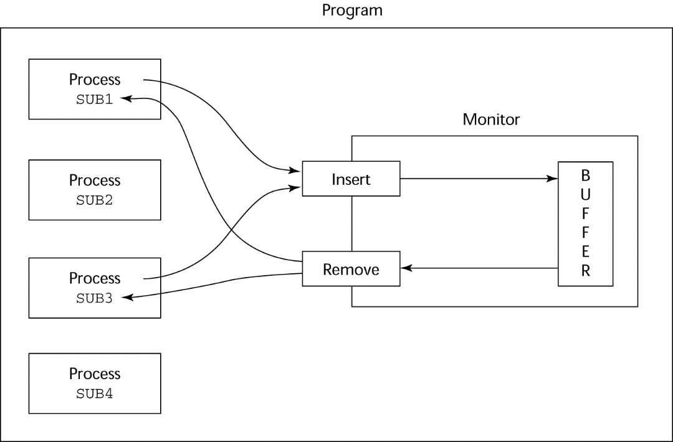
Cooperation Synchronization
Cooperation between processes is still a programming task
  Programmer must guarantee that a shared buffer does not experience underflow or overflow
Copyright © 2015 Pearson. All rights reserved.
1-<number>

Slide 48
Monitors in Java
Every object has “monitor”
You use the monitor by prefacing a data member or method of that object with the keyword: synchronized
We could solve the previous problem with monitors instead of semaphores
1-<number>

Slide 49
Monitor Version of Producer-Consumer (Java’ish Version)
Class Netflix-Buffer {
private int netflix_buffer [] = new … [100];
…constructor
public synchronized empty () {…}
public synchronized full () {…}
public synchronized put_next (…) {…}
public synchronized get_next () {…}
… ok to have non-synchronized methods
}
1-<number>

Slide 50
Evaluation of Monitors
A better way to provide competition synchronization than are semaphores
Semaphores can be used to implement monitors
Monitors can be used to implement semaphores
Support for cooperation synchronization is very similar as with semaphores, so it has the same problems
Copyright © 2015 Pearson. All rights reserved.
1-<number>

Slide 51
Message Passing *
Message passing is a general model for concurrency
  It can model both semaphores and monitors
  It is not just for competition synchronization
Central idea: task communication is like seeing a doctor--most of the time she waits for you or you wait for her, but when you are both ready, you get together, or rendezvous
Synchronous or Asynchronous
Copyright © 2015 Pearson. All rights reserved.
1-<number>

Slide 52
Message Passing Rendezvous *
To support concurrent tasks with message passing, a language needs:
- A mechanism to allow a task to indicate when it is willing to accept messages
- A way to remember who is waiting to have its message accepted and some “fair” way of choosing the next message
When a sender task’s message is accepted by a receiver task, the actual message transmission is called a rendezvous
Copyright © 2015 Pearson. All rights reserved.
1-<number>

Slide 53
Ada Support for Concurrency
The Ada 83 Message-Passing Model
  Ada tasks have specification and body parts, like packages; the spec has the interface, which is the collection of entry points:
  task Task_Example is
  entry ENTRY_1 (Item : in Integer);
  end Task_Example;
Copyright © 2015 Pearson. All rights reserved.
1-<number>

Slide 54
Task Body
The body task describes the action that takes place when a rendezvous occurs
A task that sends a message is suspended while waiting for the message to be accepted and during the rendezvous
Entry points in the spec are described with accept clauses in the body
  accept entry_name (formal parameters) do
  ...
  end entry_name;
Copyright © 2015 Pearson. All rights reserved.
1-<number>

Slide 55
Example of a Task Body
task body Task_Example is
begin
loop
accept Entry_1 (Item: in Float) do
...
end Entry_1;
end loop;
end Task_Example;
Copyright © 2015 Pearson. All rights reserved.
1-<number>

Slide 56
Ada Message Passing Semantics
The task executes to the top of the accept clause and waits for a message
During execution of the accept clause, the sender is suspended
accept parameters can transmit information in either or both directions
Every accept clause has an associated queue to store waiting messages
Copyright © 2015 Pearson. All rights reserved.
1-<number>

Slide 57
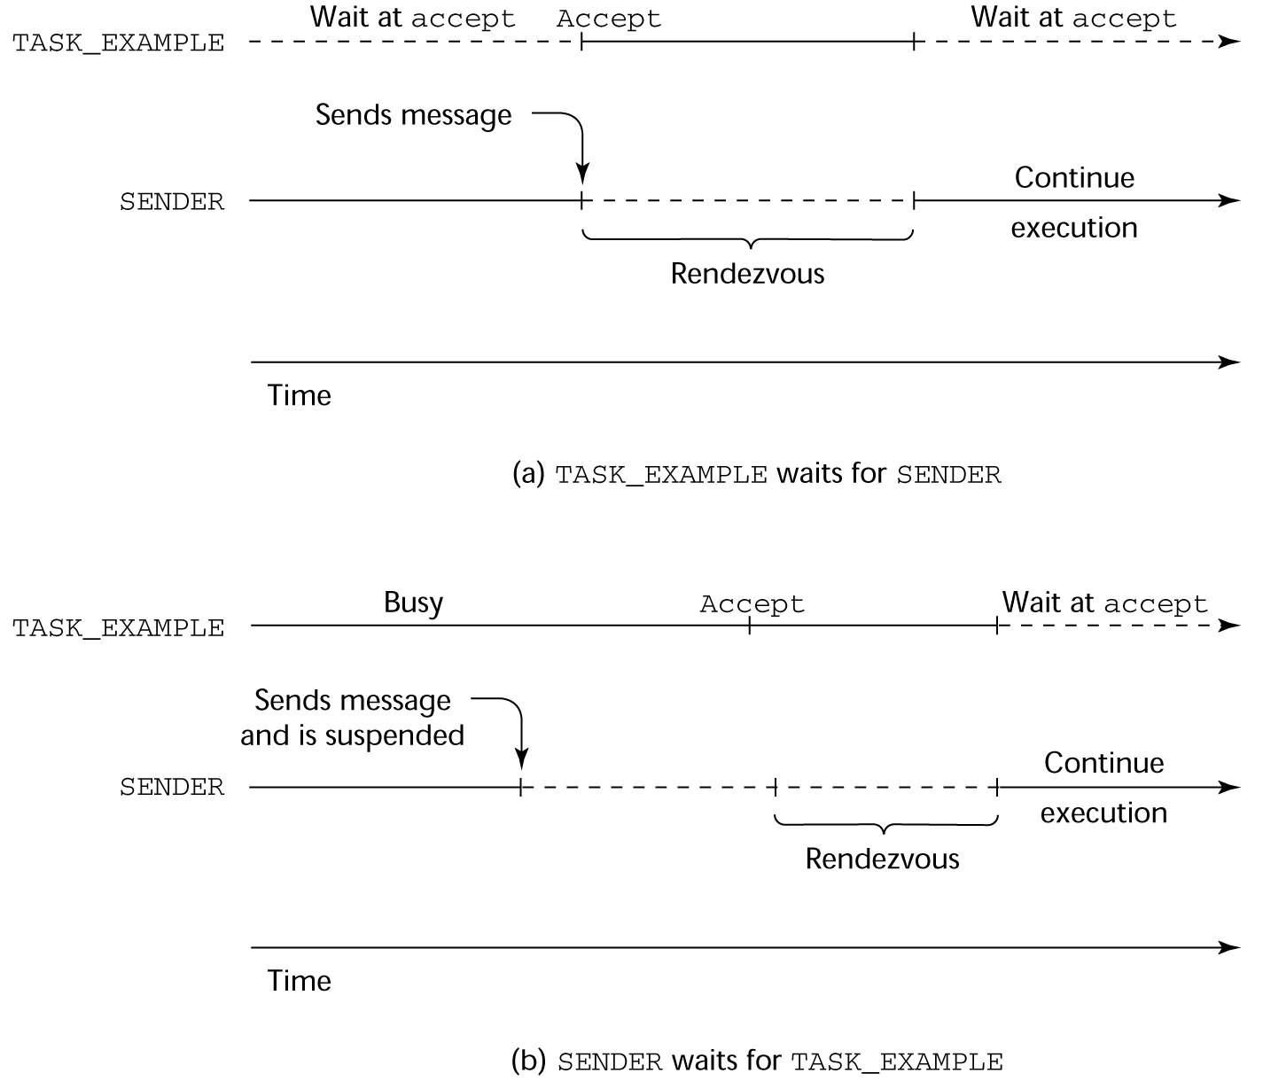
Rendezvous Time Lines
Copyright © 2015 Pearson. All rights reserved.
1-<number>

Slide 58
Message Passing: Server/Actor Tasks
A task that has accept clauses, but no other code is called a server task (the example above is a server task)
A task without accept clauses is called an actor task
  An actor task can send messages to other tasks
  Note: A sender must know the entry name of the receiver, but not vice versa (asymmetric)
Copyright © 2015 Pearson. All rights reserved.
1-<number>

Slide 59
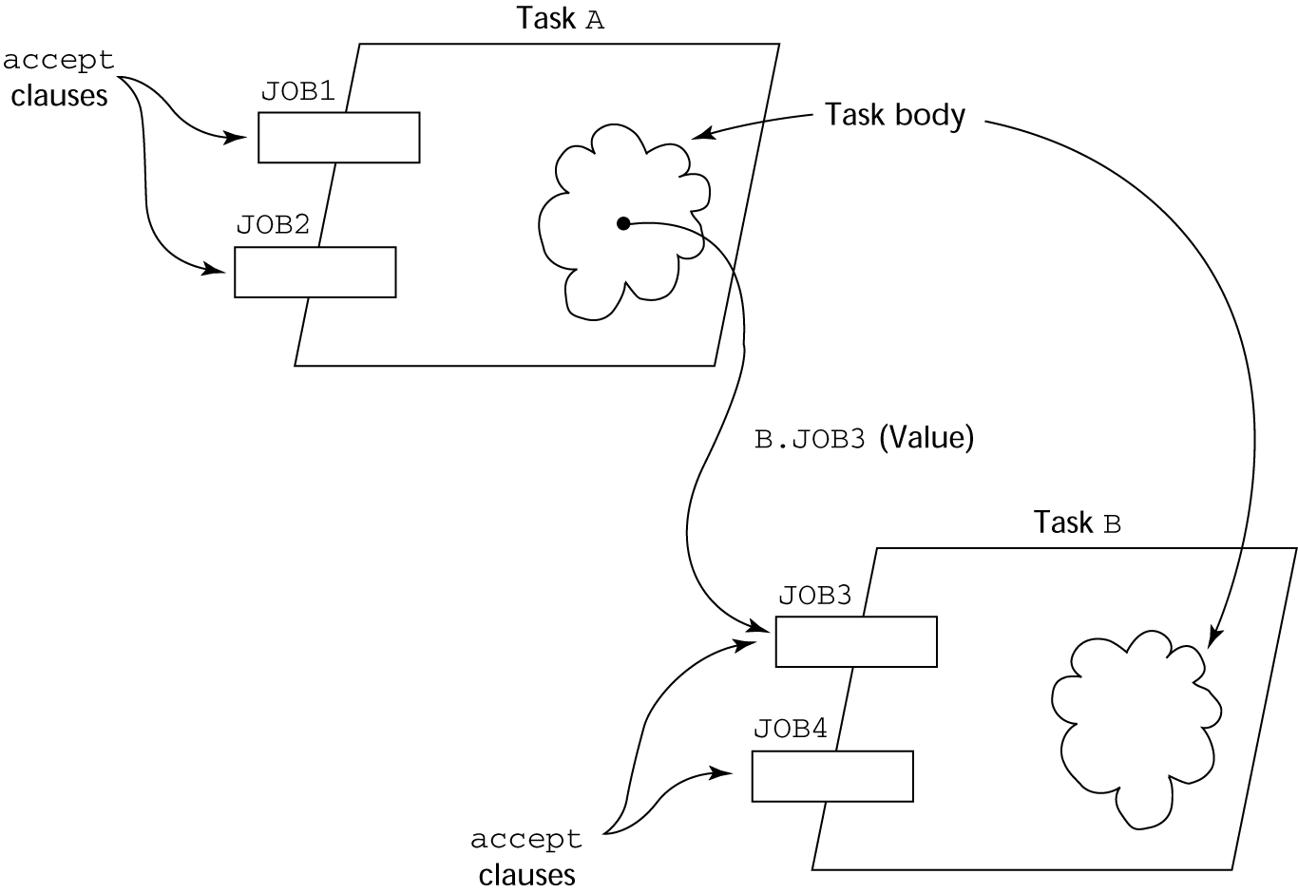
Graphical Representation of a Rendezvous
Copyright © 2015 Pearson. All rights reserved.
1-<number>

Slide 60
Multiple Entry Points
Tasks can have more than one entry point
  The specification task has an entry clause for each
  The task body has an accept clause for each entry clause, placed in a select clause, which is in a loop
Copyright © 2015 Pearson. All rights reserved.
1-<number>

Slide 61
A Task with Multiple Entries
  task body Teller is
loop
select
accept Drive_Up(formal params) do
...
end Drive_Up;
...
or
accept Walk_Up(formal params) do
...
end Walk_Up;
...
end select;
end loop;
end Teller;
Copyright © 2015 Pearson. All rights reserved.
1-<number>

Slide 62
Semantics of Tasks with Multiple accept Clauses
If exactly one entry queue is nonempty, choose a message from it
If more than one entry queue is nonempty, choose one, nondeterministically, from which to accept a message
If all are empty, wait
The construct is often called a selective wait
Extended accept clause - code following the clause, but before the next clause
  Executed concurrently with the caller
Copyright © 2015 Pearson. All rights reserved.
1-<number>

Slide 63
Cooperation Synchronization with Message Passing
Provided by Guarded accept clauses
when not Full(Buffer) =>
accept Deposit (New_Value) do
...
end
An accept clause with a with a when clause is either open or closed
  A clause whose guard is true is called open
  A clause whose guard is false is called closed
  A clause without a guard is always open
Copyright © 2015 Pearson. All rights reserved.
1-<number>

Slide 64
Semantics of select with Guarded accept Clauses:
select first checks the guards on all clauses
If exactly one is open, its queue is checked for messages
If more than one are open, non-deterministically choose a queue among them to check for messages
If all are closed, it is a runtime error
A select clause can include an else clause to avoid the error
  When the else clause completes, the loop repeats
Copyright © 2015 Pearson. All rights reserved.
1-<number>

Slide 65
Competition Synchronization with Message Passing
Modeling mutually exclusive access to shared data
Example--a shared buffer
Encapsulate the buffer and its operations in a task
Competition synchronization is implicit in the semantics of accept clauses
  Only one accept clause in a task can be active at any given time
Copyright © 2015 Pearson. All rights reserved.
1-<number>

Slide 66
Partial Shared Buffer Code
task body Buf_Task is
Bufsize : constant Integer := 100;
Buf : array (1..Bufsize) of Integer;
Filled : Integer range 0..Bufsize := 0;
Next_In, Next_Out : Integer range 1..Bufsize := 1;
begin
loop
select
when Filled < Bufsize =>
accept Deposit(Item : in Integer) do
Buf(Next_In) := Item;
end Deposit;
Next_In := (Next_In mod Bufsize) + 1;
Filled := Filled + 1;
or
...
end loop;
end Buf_Task;
Copyright © 2015 Pearson. All rights reserved.
1-<number>

Slide 67
A Consumer Task
task Consumer;
task body Consumer is
Stored_Value : Integer;
begin
loop
Buf_Task.Fetch(Stored_Value);
-- consume Stored_Value –
end loop;
end Consumer;
Copyright © 2015 Pearson. All rights reserved.
1-<number>

Slide 68
Concurrency in Ada 95
Ada 95 includes Ada 83 features for concurrency, plus two new features
  Protected objects: A more efficient way of implementing shared data to allow access to a shared data structure to be done without rendezvous
  Asynchronous communication
Copyright © 2015 Pearson. All rights reserved.
1-<number>

Slide 69
Ada 95: Protected Objects
A protected object is similar to an abstract data type
Access to a protected object is either through messages passed to entries, as with a task, or through protected subprograms
A protected procedure provides mutually exclusive read-write access to protected objects
A protected function provides concurrent read-only access to protected objects
Copyright © 2015 Pearson. All rights reserved.
1-<number>

Slide 70
Evaluation of the Ada
Message passing model of concurrency is powerful and general
Protected objects are a better way to provide synchronized shared data
In the absence of distributed processors, the choice between monitors and tasks with message passing is somewhat a matter of taste
For distributed systems, message passing is a better model for concurrency
Copyright © 2015 Pearson. All rights reserved.
1-<number>

Slide 71
Statement-Level Concurrency
Objective: Provide a mechanism that the programmer can use to inform compiler of ways it can map the program onto multiprocessor architecture
Minimize communication among processors and the memories of the other processors
Copyright © 2015 Pearson. All rights reserved.
1-<number>

Slide 72
Statement-Level Concurrency Example
REAL list_1(1000), list_2(1000)
INTEGER list_3(500), list_4(501)
!HPF$ PROCESSORS proc (10)
!HPF$ DISTRIBUTE (BLOCK) ONTO procs ::
list_1, list_2
!HPF$ ALIGN list_1(index) WITH
list_4 (index+1)
…
list_1 (index) = list_2(index)
list_3(index) = list_4(index+1)
Copyright © 2015 Pearson. All rights reserved.
1-<number>

Slide 73
Statement-Level Concurrency (continued)
FORALL statement is used to specify a list of statements that may be executed concurrently
FORALL (index = 1:1000)
list_1(index) = list_2(index)
Specifies that all 1,000 RHSs of the assignments can be evaluated before any assignment takes place
Copyright © 2015 Pearson. All rights reserved.
1-<number>

Slide 74
Summary
Concurrent execution can be at the instruction, statement, or subprogram level
Physical concurrency: when multiple processors are used to execute concurrent units
Logical concurrency: concurrent united are executed on a single processor
Two primary facilities to support subprogram concurrency: competition synchronization and cooperation synchronization
Mechanisms: semaphores, monitors, rendezvous, threads
High-Performance Fortran provides statements for specifying how data is to be distributed over the memory units connected to multiple processors
Copyright © 2015 Pearson. All rights reserved.
1-<number>

